Slide 1


CAPSTONE PROJECT
UCI Mechanical Analysis Data Set
Presented By:
1. E.Saravanan -Solamalai College of Engineering-Mechanical Engineering

Slide 2
OUTLINE
○
Probelm Statement
Proposed Solution
System Approach
Algorithm & Deployment
Result
Conclusion
Future Scope
References
○ ○ ○ ○
○
○ ○

Slide 3
PROBLEM STATEMENT
The UCI Mechanical Analysis dataset is used for predicting the mechanical properties of metal alloys based on their chemical composition and processing conditions. The problem statement involves developing a predictive model that can accurately estimate mechanical properties such as yield strength, tensile strength, and elongation based on input features like alloy composition, temperature, and time of processing. This task typically falls under the domain of materials science and machine learning, aiming to improve the efficiency and accuracy of material property predictions in industrial processes.

Slide 4
PROPOSED SOLUTION
For the UCI Mechanical Analysis dataset, a proposed solution involves several steps: *Data Preprocessing: This includes handling missing values, encoding categorical variables, and scaling numerical features. Feature Engineering: Extract meaningful features from the raw data, such as calculating alloy compositions, combining related features, or creating new features through domain knowledge. Model Selection: Experiment with various machine learning algorithms such as linear regression, random forest, gradient boosting, or neural networks to find the best-performing model for predicting mechanical properties. Model Training:Train the selected model on the preprocessed data, using techniques like cross-validation to tune hyperparameters and prevent overfitting.

Slide 5
SYSTEM APPROACH
Understanding the Dataset: Begin by thoroughly understanding the dataset's structure, including the meaning and type of each feature, the target variable(s) to predict, and any inherent patterns or biases.Exploratory Data Analysis (EDA): Conduct exploratory data analysis to gain insights into the distribution of features, identify correlations between variables, and detect any outliers or missing values that may require preprocessing.Data Preprocessing: Preprocess the data by handling missing values, encoding categorical variables, and scaling numerical features as necessary. Additionally, consider feature normalization or transformation to improve model performance.Feature Engineering: Create new features or transform existing ones based on domain knowledge to enhance the predictive power of the model. This may involve combining related features, generating interaction terms, or deriving meaningful features from raw data.

Slide 6
ALGORITHM & DEPLOYMENT
Algorithm Selection:** - Begin by trying out various regression algorithms suitable for predicting continuous mechanical properties. Common choices include linear regression, decision trees, random forests, gradient boosting machines (GBM), and neural networks. - Evaluate each algorithm's performance using cross-validation and appropriate evaluation metrics like mean squared error (MSE) or R-squared score.Model Training:** - Once you've selected the algorithm, train it on the preprocessed dataset. Use techniques like cross-validation and hyperparameter tuning to optimize the model's performance. - Split the dataset into training and validation sets to train the model on one subset and validate its performance on the other.

Slide 7
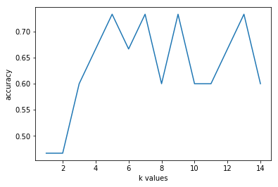
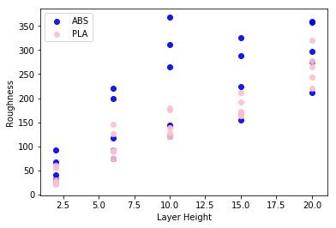
RESULT

Slide 8
CONCLUSION
Understanding Material Properties: The dataset highlights the complex relationship between alloy composition, processing parameters, and mechanical properties. Through thorough analysis, we can gain insights into the factors influencing material behavior.Predictive Modeling: By leveraging machine learning algorithms, we can build predictive models that estimate mechanical properties such as yield strength, tensile strength, and elongation with reasonable accuracy. The choice of algorithm and feature engineering techniques significantly impact model performance.Deployment in Industrial Settings: Deploying these models in industrial settings offers the potential to enhance efficiency, quality control, and process optimization. Real-time predictions based on alloy compositions and processing conditions can inform decision-making and improve outcomes.

Slide 9
FUTURE SCOPE
Advanced Modeling Techniques: Future research could explore the application of advanced machine learning techniques such as deep learning and reinforcement learning to improve predictive accuracy and capture complex relationships within the data. These techniques may uncover hidden patterns and insights that traditional algorithms might overlook.Multi-Objective Optimization: Beyond predicting individual mechanical properties, there's an opportunity to optimize multiple objectives simultaneously. Future work could focus on developing optimization algorithms that consider trade-offs between different mechanical properties and processing parameters to achieve desired material characteristics.

Slide 10
REFERENCES
https://www.kaggle.com/datasets/afumetto/3dprinter

Slide 11
THANK YOU

